Slide 1
Chapter four
Advanced Enterprise Software Development

Slide 2
Chapter outline
MVC Design Pattern
Model: Java Bean
View: Java Server Pages (JSP)
Control: Java Servlet
Software Framework
Microservices
Restful Web Service

Slide 3
Web Programming in Java
Fundamental Java Web Technologies
Java Servlet
Java Server Pages (JSP)
Enterprise JavaBean (EJB)
Advanced Technologies
Software Framework (Portlet, struts, spring, JSF, etc.)
Require some advanced object oriented programming skills
Software Platform (Liferay, Jakarta Pluto, EXO Platform, etc.)
Require little programming skills
Require system administrative skills
Technologies Standardization: Java Enterprise Edition (Java EE)
Provides many web technology standards for development.
The Java Community Process (JCP) defines the standard detail in Java Specification Requests (JSR) http://jcp.org/en/jsr/all (List of all JSR).

Slide 4
3.1 Java server Pages

Slide 5
What is Jsp?
A Java Server Pages (JSP) is a technology that let's software developers create dynamically generated web pages based on HTML.
A JSP is similar to PHP in that it is a markup that is a combination of HTML and Java where as PHP was a combination of HTML and PHP. It is also similar to ASP from Microsoft that was a combination of C# and HTML.
A JSP is compiled into a Servlet!

Slide 6
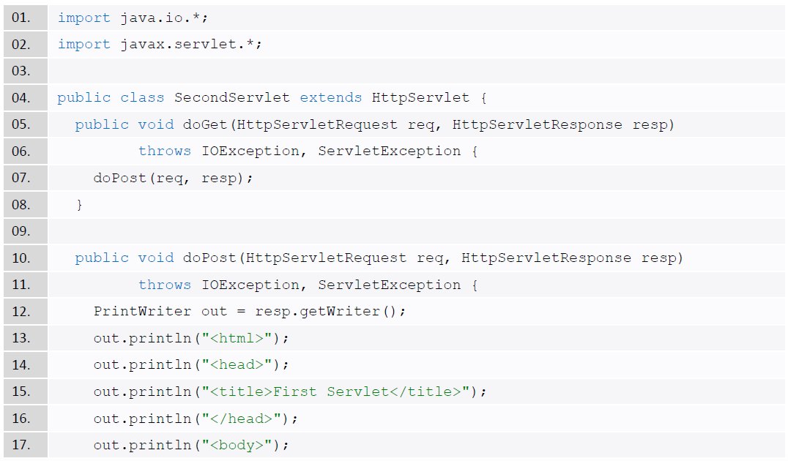
Java Servlet Example

Slide 7
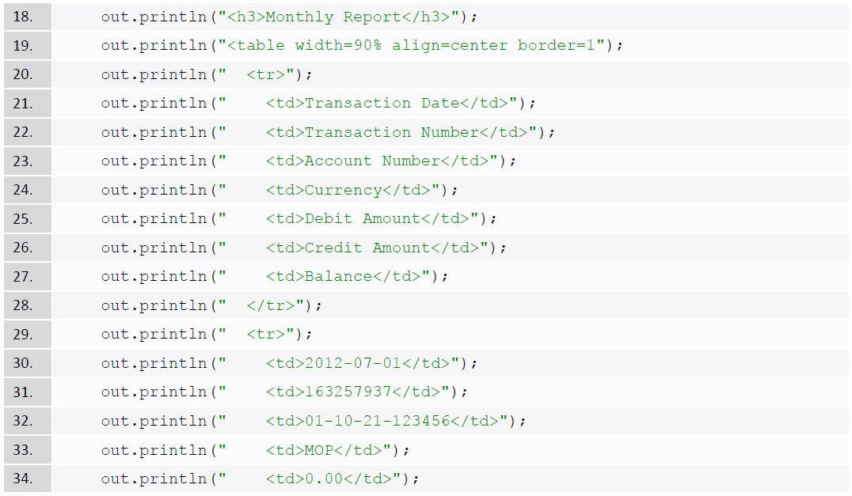
Java Servlet Example (cont.)

Slide 8
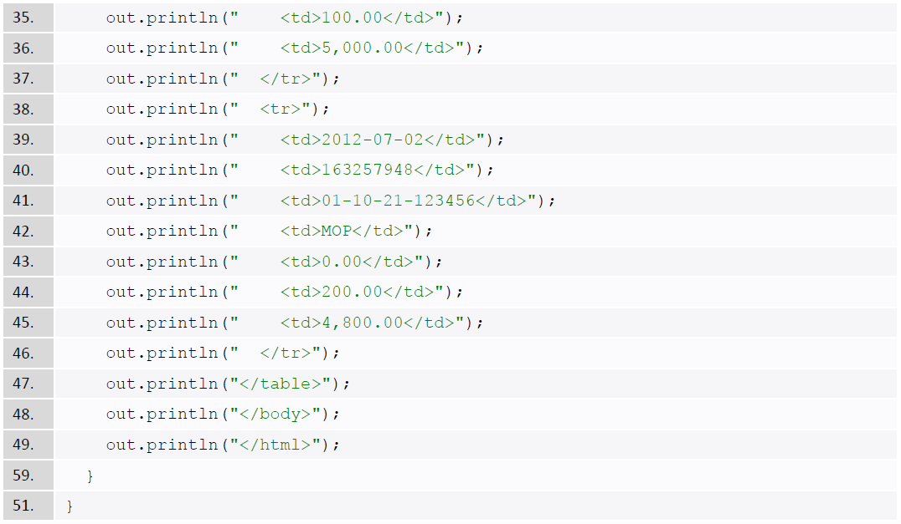
Java Servlet Example (cont.)

Slide 9
Java Servlet Problem
Using Java Servlet to show lengthy HTML content and to show special characters are awkward.
Since HTML codes are embedded inside Java Servlets, it is very hard for web designers to change the look-and-view of the web pages.
Mixing HTML with Java code is simply a mess (spaghetti code).
So, how to simplify on coding a large web page in Java Servlet?

Slide 10


Introduction to Java Server Pages (JSP)
Writing plenty of HTML code inside a Java Servlet is a nightmare
JSP on the other hand is writing Java code inside the HTML files
JSP helps to present the HTML response objects easily
Changing a Java Servlet may require restarting server to take effect, but JSP is complied in run-time. So, we can always get the latest version of our web applications
JSP is the extension of Java Servlet, and container will translate JSP into servlet (Java file), so you don’t need to compile JSP file
Is loaded and
Initialized as
writes
Is translated to
Compiles to
Servlet
Object
Developer
MyJSP.jsp
MyJSP.java
MyJSP.class
MyJSP_jsp
Servlet

Slide 11
Process of translating and running JSP pages
Web
request
JSP Servlet ?
JSP Container
Translate JSP
Into Servlet
No
Compile
Servlet
Yes
Complied Servlet
Process request using logic from JSP Pages
Web
response

Slide 12
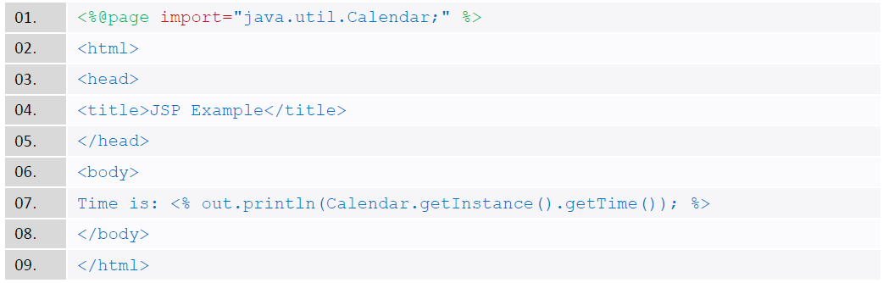
JSP Example
Developing JSP program is liked writing normal HTML file.
If you want to inject some Java codes, simply surround the Java codes with <% ..%> tags.
SystemTime.jsp

Slide 13
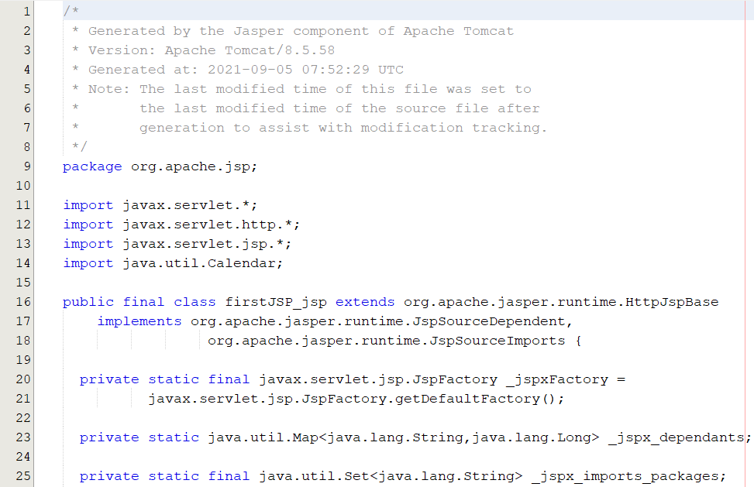
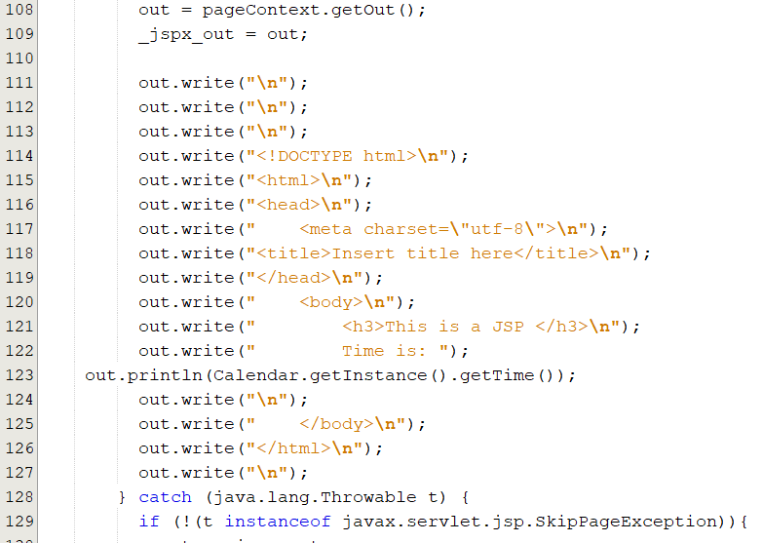
Convert JSP to Java Class
Web container converts JSP to a Java class or a Java Servlet.
……

Slide 14
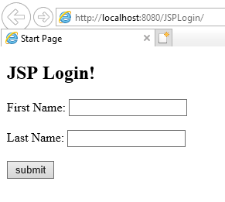
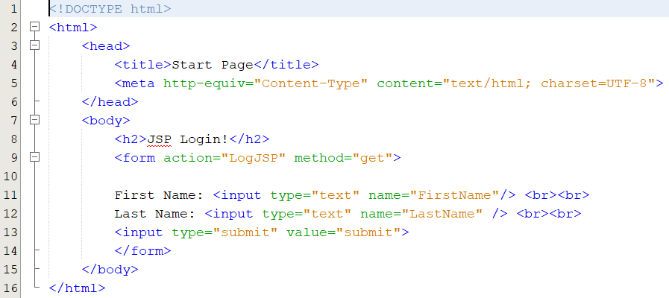
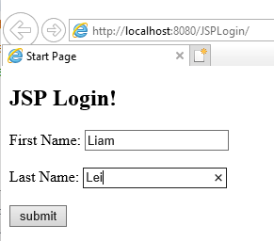
JSP Login Example （index.html）

Slide 15
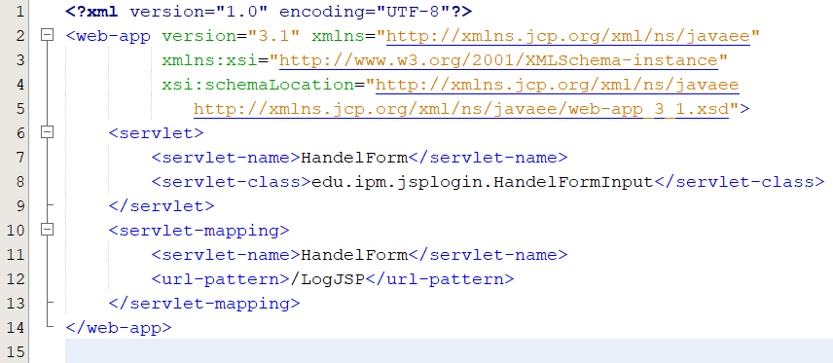
JSP Login Example （web.xml）

Slide 16
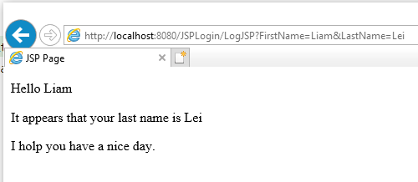
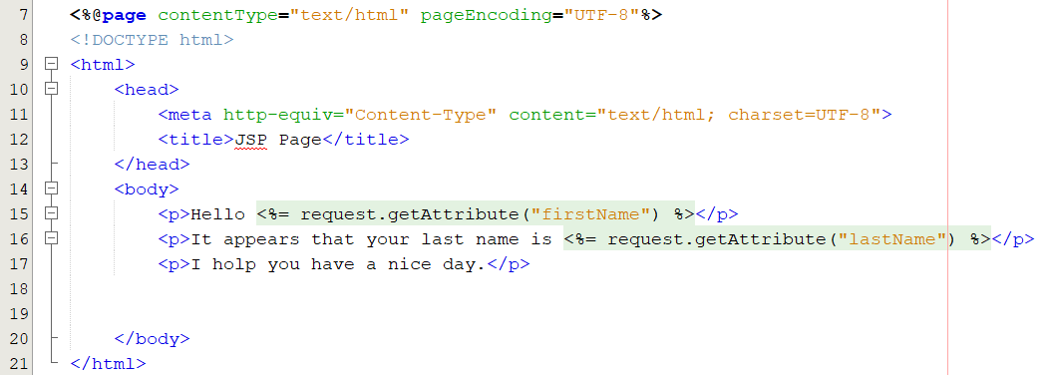
JSP Login Example （response.jsp）

Slide 17
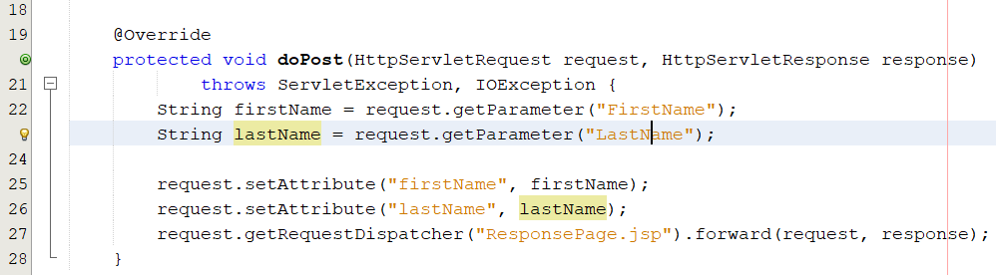
JSP Login Example （DoPost method）

Slide 18
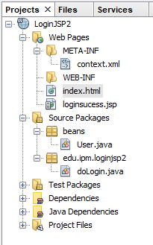
JSP + servlet Login Example
Project Structure
index.html (the web application home page).
doLogin.java (servlet for handling request and response)
User.java (the JavaBean for modeling the user data)
loginsucess.jsp (a jsp document for handling how to represent the response to the client)

Slide 19
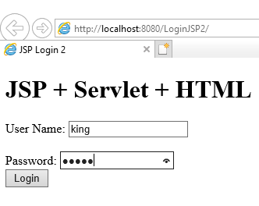
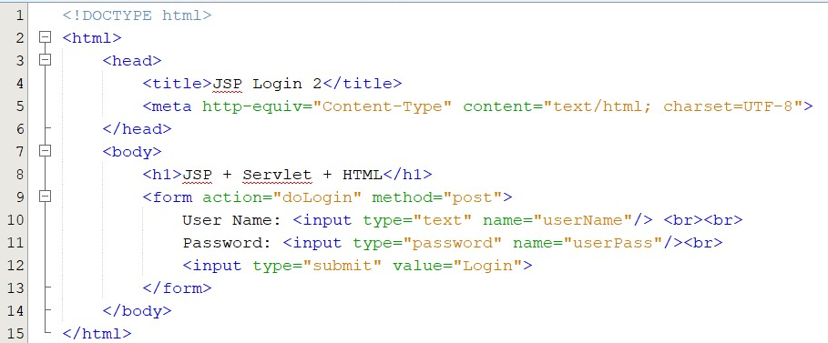
JSP + servlet Login Example
index.html

Slide 20
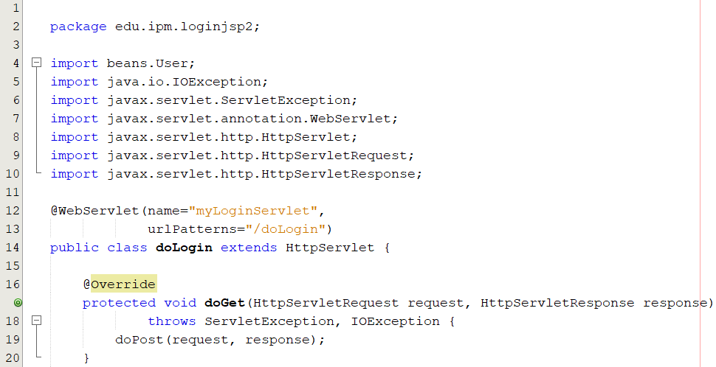
JSP + servlet Login Example
doLogin.java: doGet()
Import dependences libraries
Mapping a Servlet to an URL
doGet() method

Slide 21
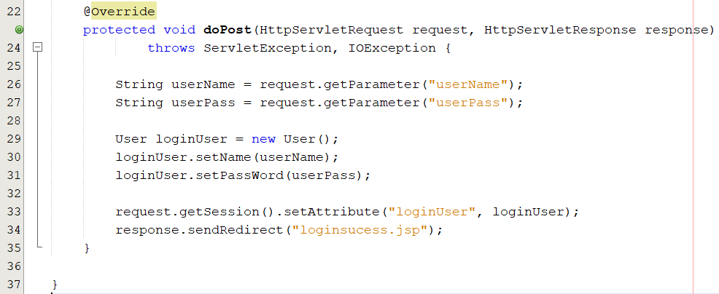
JSP + servlet Login Example
doLogin.java: doPost()
Get user's information
from the request
Create an User object
to store user's information
Send the User Bean to JSP
for forward processing

Slide 22
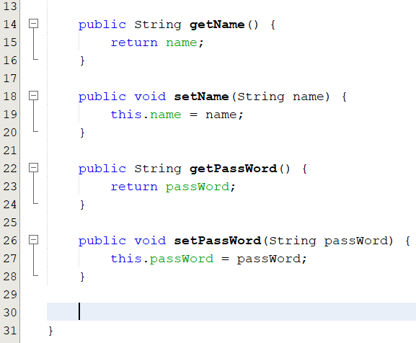
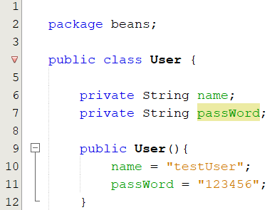
JSP + servlet Login Example
User.java (JavaBean)
member variable
Constructor
Getters and setters

Slide 23
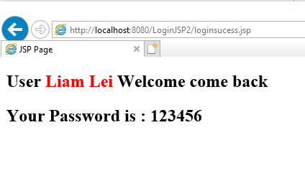
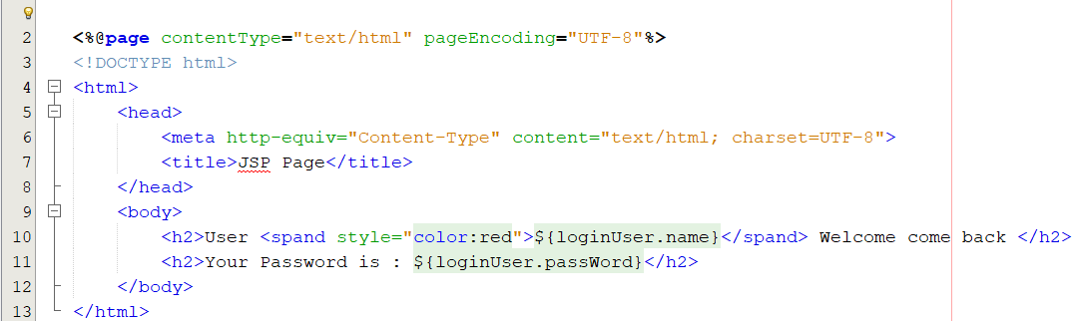
JSP + servlet Login Example
loginsucess.jsp

Slide 24
MVC Design Pattern

Slide 25
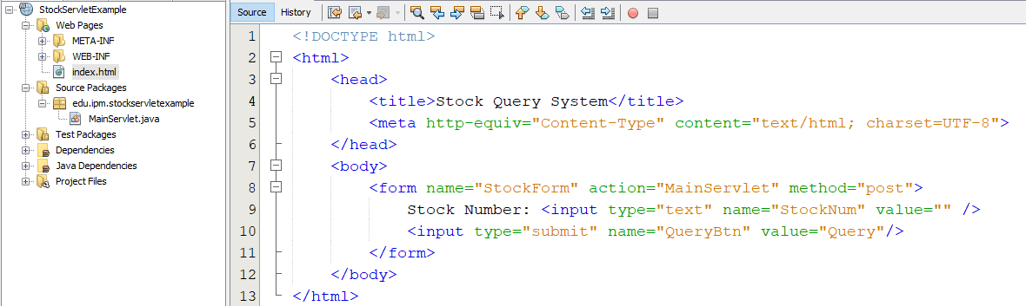
Stock System Example 1
An HTML page submits a stock number to the server, and it replies the stock information and current price.
HTML form submits to MainServlet to process the transaction.

Slide 26
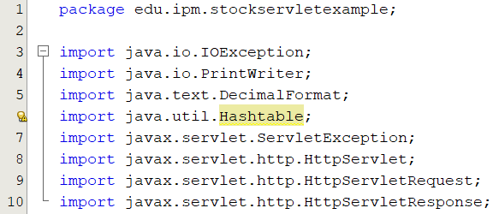
Single program (Java Servlet) to process a transaction
Import dependencies libraries.

Slide 27
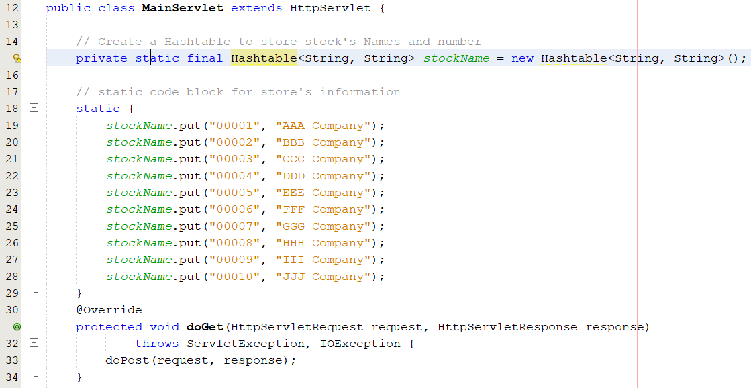
Single program (Java Servlet) to process a transaction
Store information data
doGet( )

Slide 28
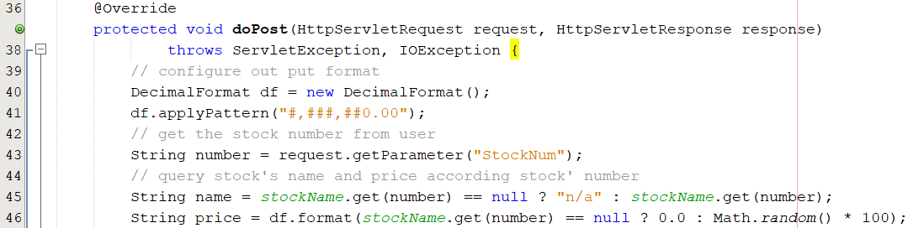
Single program (Java Servlet) to process a transaction
Handel and processing User Input

Slide 29
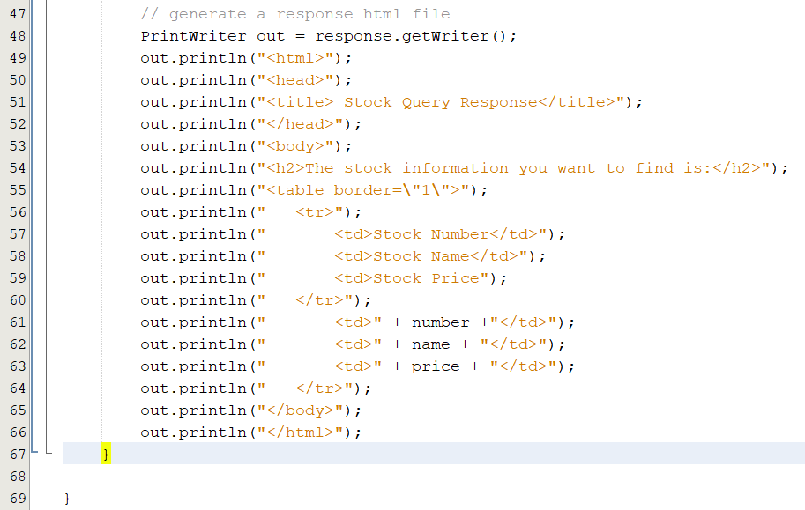
Single program (Java Servlet) to process a transaction
Display query result to user

Slide 30
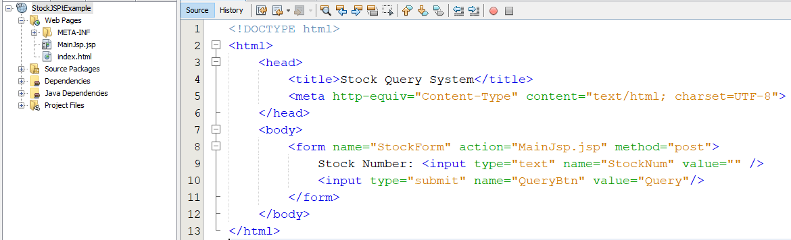
Stock System Example 2
An HTML page submits a stock number to the server, and it replies the stock information and current price.
HTML form submits to MainJsp.jsp to process the transaction.

Slide 31
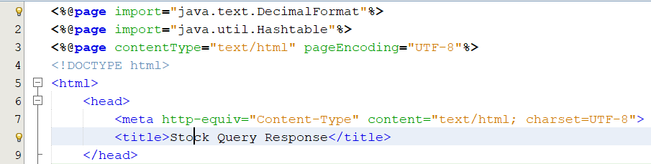
single program (JSP) to process a transaction
Import dependencies libraries.

Slide 32
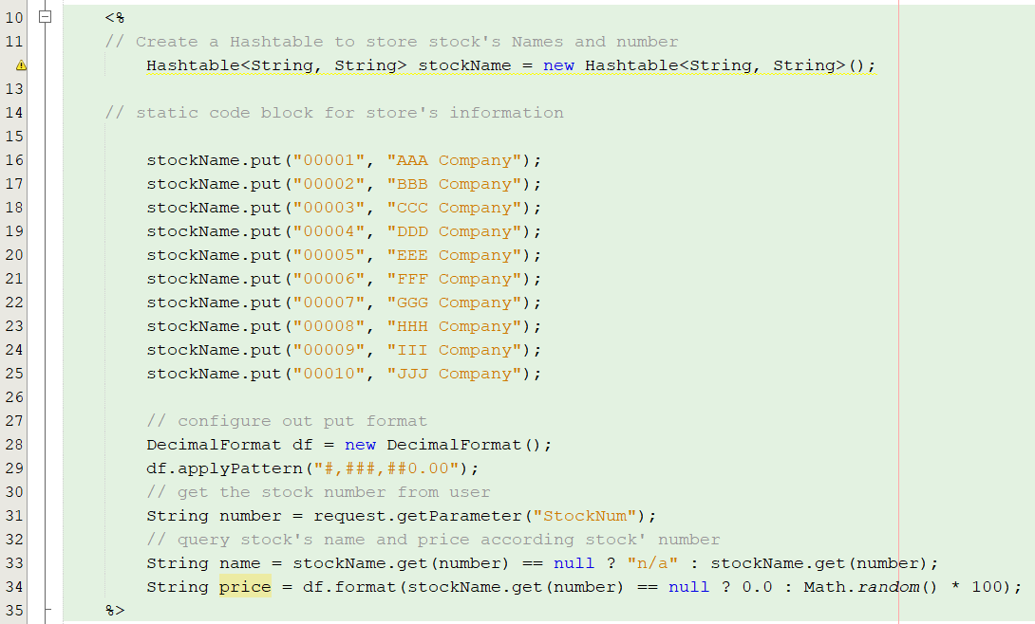
single program (JSP) to process a transaction

Slide 33
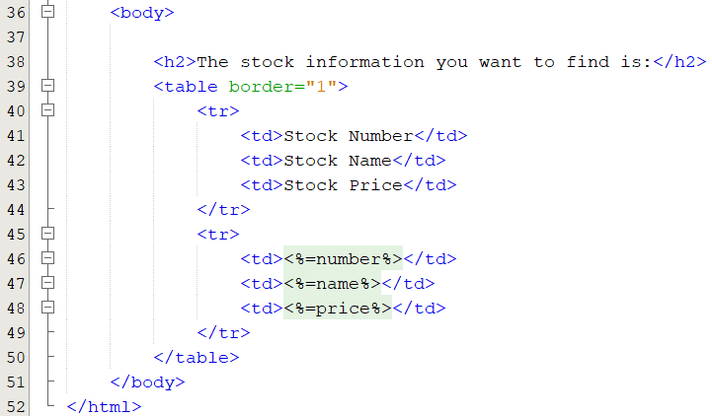
single program (JSP) to process a transaction

Slide 34
Problem & Solution
Problems
Presentation, Business Logic, Control flow, and Data layers are bounced together. This all-in-one program is lengthy and is not easy to maintain.
Logic and presentation layer cannot be reused. It is not flexible and extensible for future requirements.
Any modification may affect the correctness of processing the whole transaction.
Solutions
We should separate the program according to their functional purposes into different modules.
We should adopt the MVC design pattern.
We can use Java Servlet, JSP, and JavaBean web technologies to architect this transaction.

Slide 35
Introduction to the MVC Design pattern
The MVC architecture pattern turns complex application development into a much more manageable process. It allows several developers to simultaneously work on the application.
The MVC design pattern is used to build the Presentation (Web) Layer.
The MVC design pattern helps to enforce separation of concerns to help you avoid mixing presentation logic, business logic, and data access logic together.
What is MVC?
MVC stands for model-view-controller. Here's what each of those components mean:
Model: manages the behavior and data from the application layers
View: manages the display of data (The frontend or graphical user interface)
Controller: handles page events and navigation between pages (calls Business Services to get the (Object) Model and navigates to the next View)

Slide 36
Recap on Java Servlet, Jsp, javaBean
Java Servlet
Receives requests from client and processes the business logic.
Chooses the JavaBean model to hold the result data.
Controls the transaction workflow: calls sub functions and chooses the resulting page.
Should not have page content in most situation
Java Server Pages
Responses to client and processes the data presentation.
Retrieves the JavaBean data from request or session object.
Formats the data objects and present the data in HTML back to client.
Should not have business logic in most situation

Slide 37
Recap on Java Servlet, Jsp, javaBean
JavaBean
Keeps the transactional data temporary.
Models the data structure such as mapping a table or a transaction
Restricts the data range and format in setter methods
Should not have page content and business logic in all situations.

Slide 38
Recap on JavaBean
Server side program designed for reuse and to hold data
A package of objects: to encapsulate many objects into a single object (the bean)
It is serializable Java object to persist data through servers
Modern software frameworks use JavaBean to transform data to different style formats (database table, XML, JSON, etc.)
Enterprise JavaBeans (EJB) is a different story
Specified in Java EE where JavaBean is not
A component architecture for modular construction
Designed to handle persistence, transactional integrity and security
EJB Members: SessionBean, MessageDrivenBean, EntityBean

Slide 39
JavaBean Characteristics
A Java object implements java.io.Serializableto persist data through servers
It has no argument constructor and no main method
It contains many properties for holding data
Allow access to properties using GETTE Rand SETTER methods with its naming convention
Accessor methods (getter) to retrieve value
getXXX() method
Mutatormethods (setter) to change value
setXXX() method

Slide 40
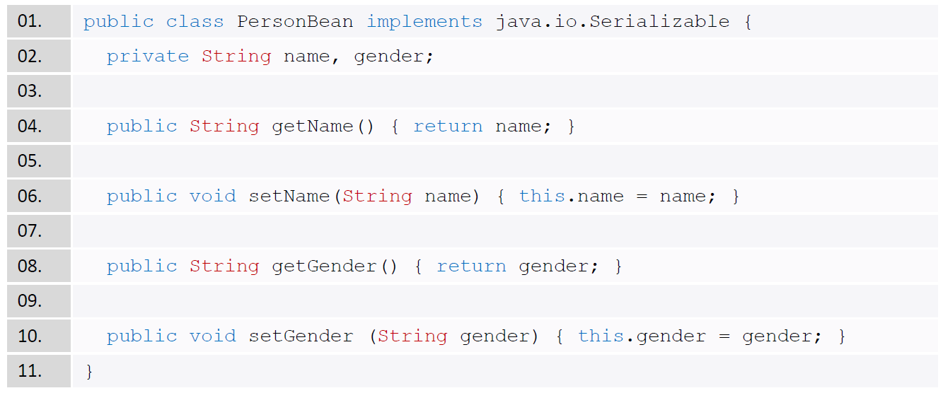
JavaBean Example: PersonBean
Create a JavaBean (PersonBean) with two properties: name and gender.
Modern IDE can help to generate the getter and setter methods.

Slide 41
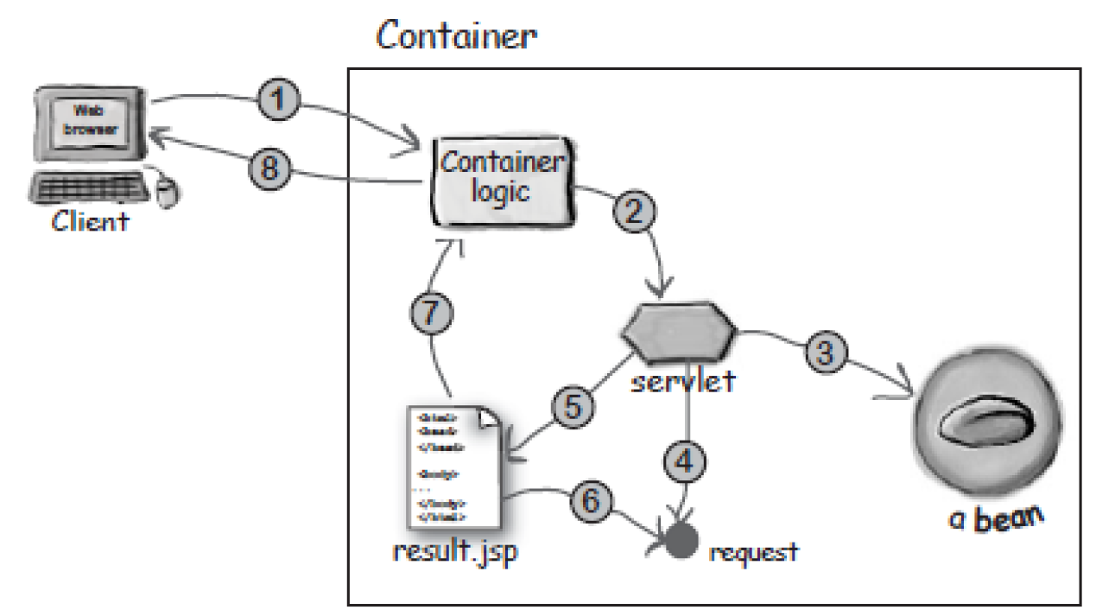
Transaction workflow diagram
Using different web technologies (Java Servlet, JSP, JavaBean) together on a backend process for an online transaction.

Slide 42
Transaction Workflow
Client sends a request to the web container;
Container finds the corresponding servlet and pass the request data to that servlet;
Servlet processes the business logic and store the result data object into a JavaBean;
Servlet adds that JavaBean to the session object inside the request object;
Servlet forwards to JSP;
JSP gets the JavaBean from the session object;
JSP converts JavaBean into HTML page format for the Container;
Container translates the JSP into plain HTML codes and returns back to client.

Slide 43
Model view Controller
Design Pattern for building web application
Making program more reusable, extensible, and easier for maintenance
Use to deal with large scale project
Break down the functional sectors into pieces instead of writing everything inside a single program
Separate the development roles
Data Modeling for system architect
Business logic and workflow for programmer
Presentation for web designer
Categorize the web technologies
Model: JavaBean, XML, etc.
View: JSP, HTML, JavaScript, Swing, JavaFX, etc.
Controller: Java Servlet, etc.
Many web development frameworks are based on MVC design pattern

Slide 44
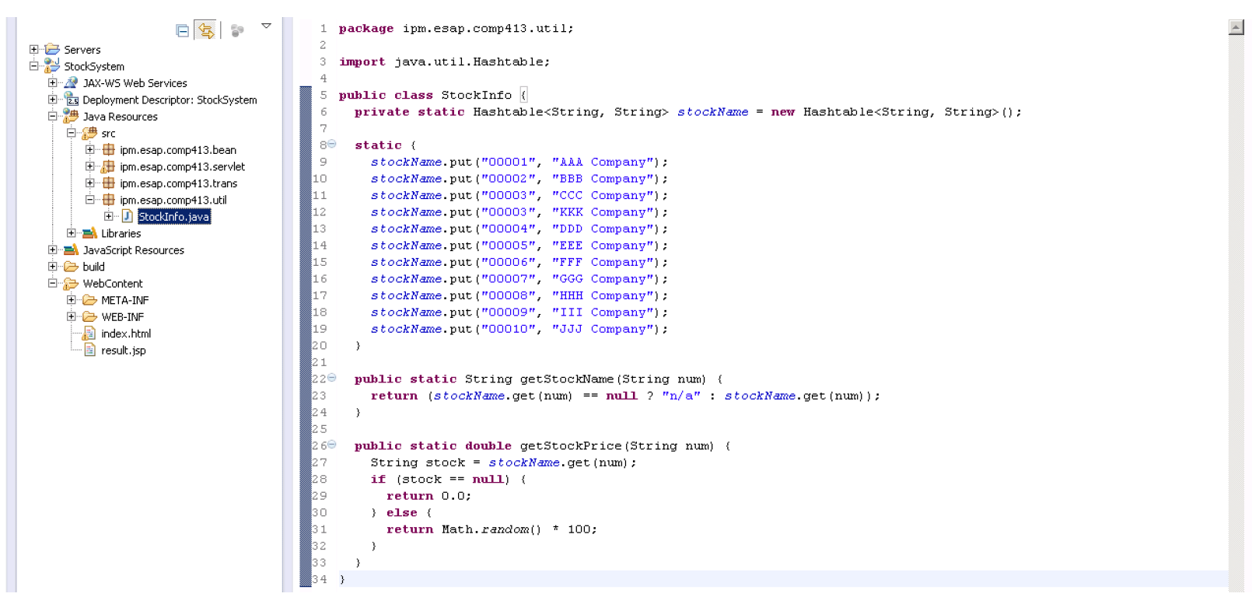
MVC (Model)
A Java program to contain static data which is part of the data model.

Slide 45
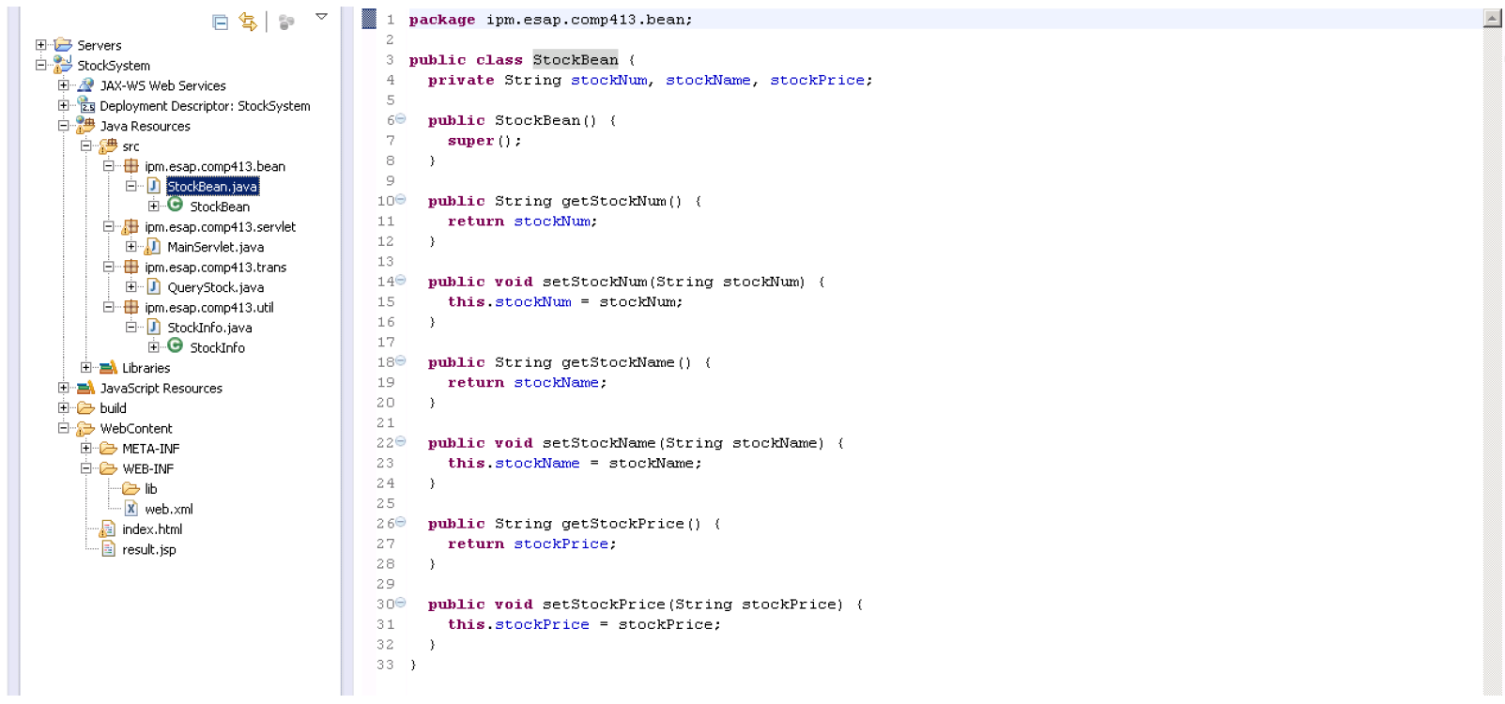
MVC (Model)
A Java Bean to hold the transactional data for passing between programs.
The transaction data model is defined according to user requirements.

Slide 46
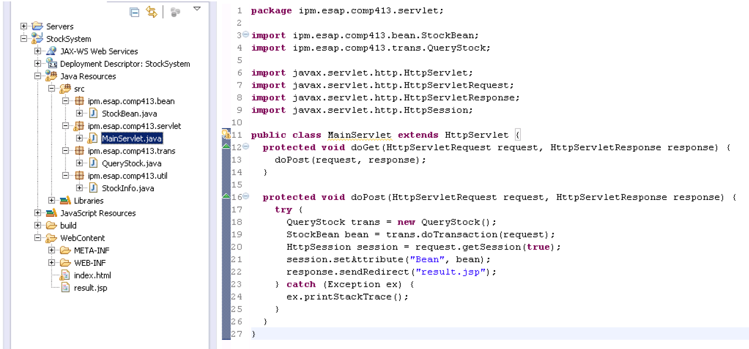
MVC (Control)
A Java Servlet to control the transaction flow.
Changing the flow will not affect other programs.

Slide 47
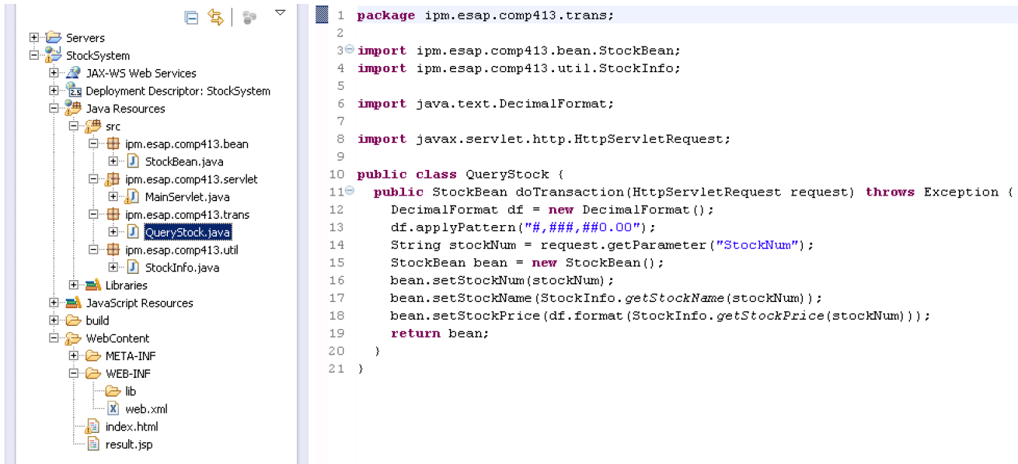
MVC (Control)
A Java program to create a transaction to query data.
The core program to apply the business logic.
This query transaction can be reused.

Slide 48
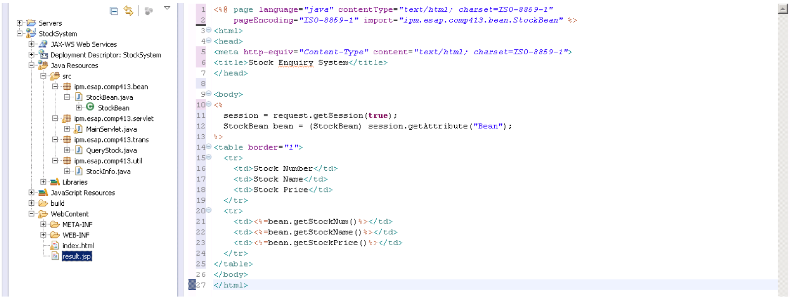
MVC (View)
JSP to present the result data (JavaBean) to client.
Clients can have different presentation to show the JavaBean.
Allow web designer to modify the JSP as ordinary web pages.

Slide 49
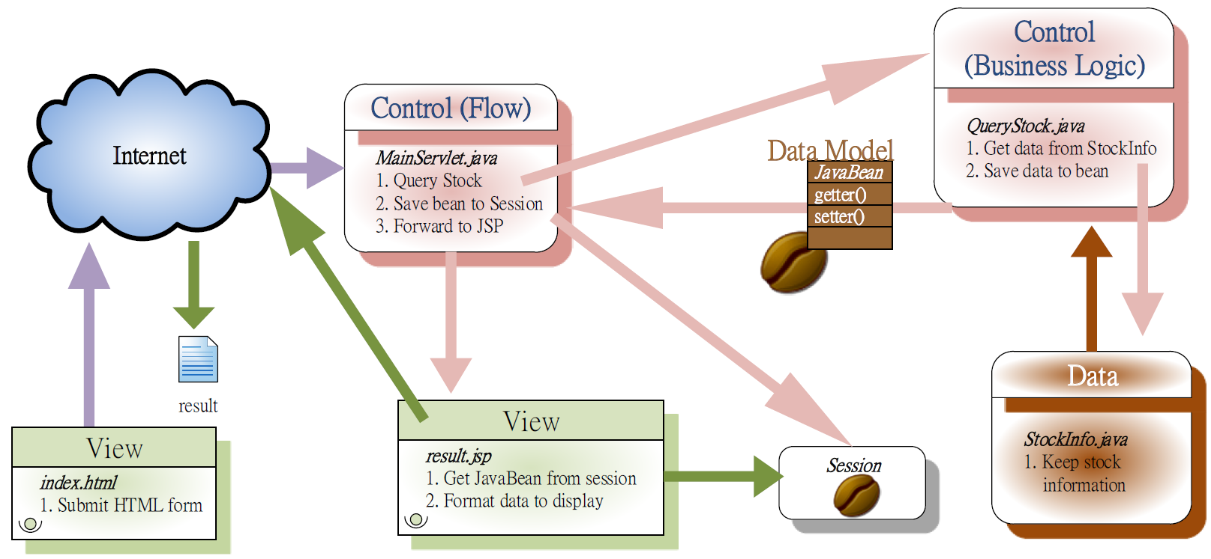
Transaction Flow Diagram
This transaction is now broken down into modules by adopting the MVC design pattern.

Slide 50
MVC Framework
MVC is a design pattern mainly to separate logic, flow, display, and data model into different programs.
Since the MVC programs are following a pattern, they must share some similarities. Therefore, software engineers will make abstraction to minimize the repeating codes. As a result, new software framework is formed.
Software framework that based on MVC model
PHP –AppFlower, CakePHP, CodeIgniter, Fakoli, FuelPHP, Joomla, Kajona, PHPixie, Prado, Symfony, Yii, Zend, Zikula, etc.
Java –Apache OfBiz, Sling, Struts, Tapestry, JavaServerFaces, JBossSeam, Spring, Stripes, Wavemaker, WebObjects, ztemplates, ZKoss, etc.
http://en.wikipedia.org/wiki/Comparison_of_web_application_frameworks

Slide 51
Software framework

Slide 52
How to start building an enterprise application?
We know MVC design pattern, database manipulation technologies but where should I start to build an enterprise application first?
When a new project comes, I need to build an application from scratch on each time but I know there are many common parts between projects.
It turns out that we are keep repeating develop the same modules (user management, database connection, transaction flow, etc.).
Is it a better way to reuse the developed programs from our previous projects?

Slide 53
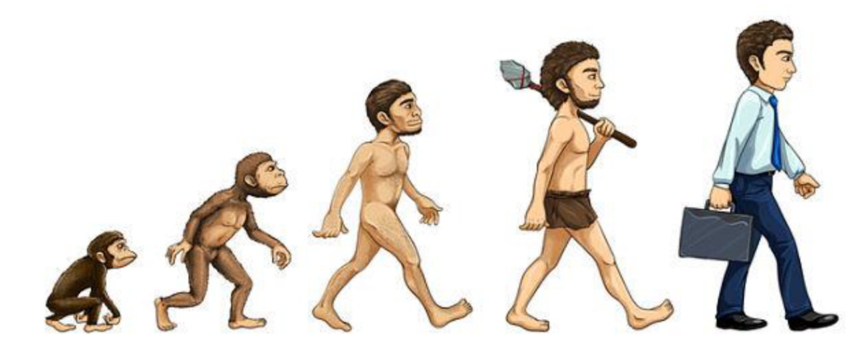
Development Evolution
All-in-one Approach
Mixing all processes in a single program
Pattern Design
Design the programs to follow the same pattern.
Distribute the MVC modules (Data Model, View, Business Logic, and workflow) into different programs.
Software Framework
Transform the pattern into a higher level for reuse

Slide 54
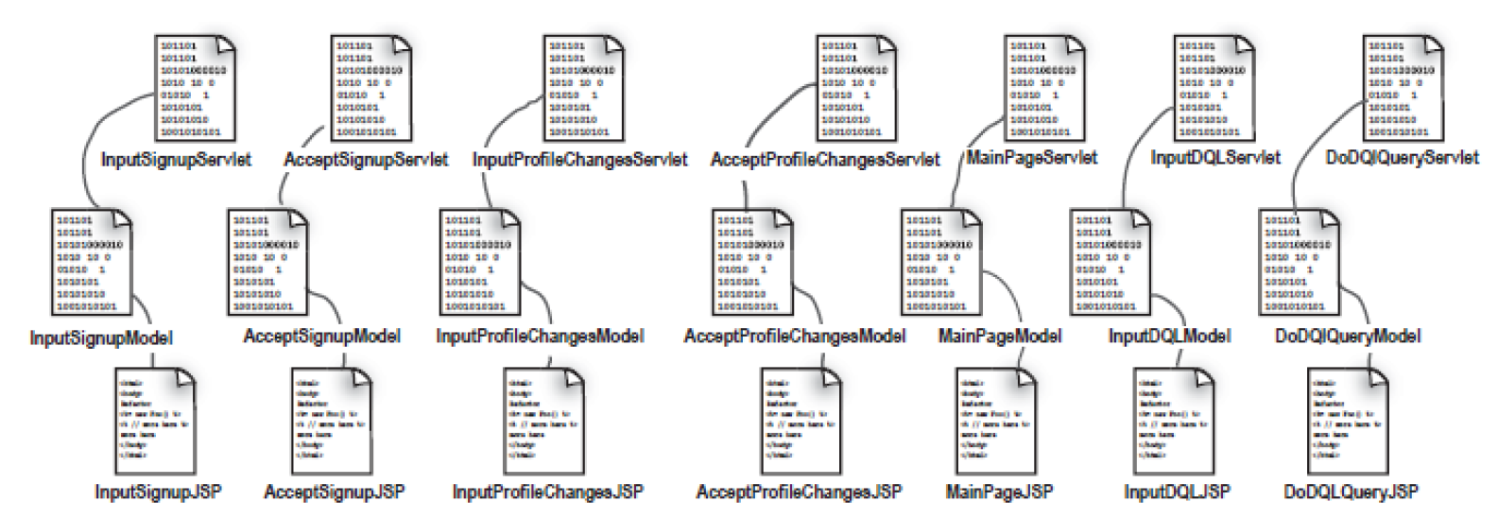
MVC Design Pattern
A transaction can be broken down into MVC modules.
When there are many transactions, similar codes and patterns are formed. Then, people start to make abstraction for simplification.
As a result, a software framework can be created based on those abstractions.

Slide 55
Designing a software framework
The general usage of software framework is to facilitate people on building applications.
Focus on different parts of a transaction to make abstraction or optimization.
Controller
Application types: Portlet, Servlet, JApplet, etc.
Abstract to XML as a framework: struts, Spring, etc.
Data Model
Abstract to XML as a framework: Hibernate, NoSQL, RESTful, etc.
Presentation
Application types: HTML (web), Pane (standalone), View (mobile), etc.
Allows to write HTML on its program: ASP, JSP, PHP, etc.
Abstract to XML as a framework: JSF, Android, etc.

Slide 56
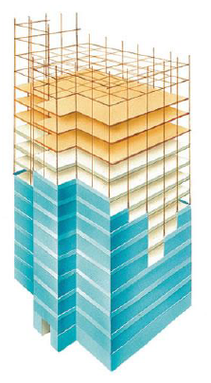
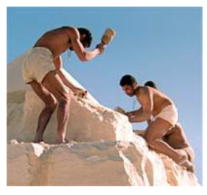
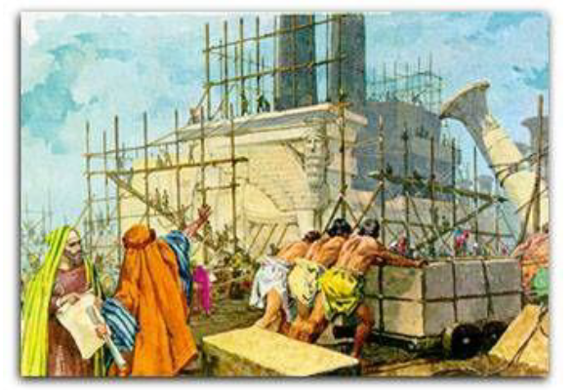
Building a Skyscraper
Building modern skyscrapers will not be the same as building the a temple in the ancient time.
Using a lot of manpower, stone by stone, and taking ages.
Using steel framework for building the skeleton and then just plug the pre-built rooms or the curtain walls with different functions (kitchen, toilet, etc.) for finishing.
Building an enterprise application can use the ideas of framework. Developers will focus only on making “rooms”.

Slide 57
What exactly it is?
Software Framework is an abstraction of software to provide generic functions that can be selectively changed by users.
It is a universal, reusable software module used to develop applications, products, and solutions.
Tries to make generalizations about the common tasks and workflow.
In an object oriented (OO) environment, a framework consists of abstract and concrete classes. Instantiate a framework consists of composing and sub-classing the existing classes.
Allow programmers to develop a project in a shorter time and to develop more reliable systems.

Slide 58
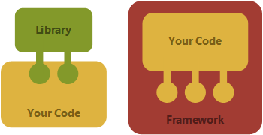
Software Framework vs Library
Library
Framework
Library is a set of reusable functions used by your program
They are important in program linking and binding process
Code calls to library
Javax.awt is a Java library for 2D Graphics.
It is a piece of code that dictates the architecture of our project
They provide a proper standard way to build an deploy program
Framework calls your code
JSF is a frame work for view

Slide 59
Framework characteristics
The following features make software framework different from normal libraries:
Inversion of Control (IoC)
Unlike procedural programming style as the flow of the business logic is statically assigned, IoC will assign the business logic at run time.
Default Behavior
Framework has default behavior to help finish some tasks.
Extensibility
It is a software that required to extend and is not finalized product.
Non-modifiable code
The framework code in general is not allowed to be modified.

Slide 60
Web Application Framework
Web application projects often adopt more than one frameworks.
There are plenty of frameworks in the market and is expanding. You will see new frameworks appear over the time.
Java: Grails, Google Web, Hibernate, IceFaces, JSF, Liferay, Seam, Oracle ADF, Sling, Spring, Struts, WebObjects, ZK, ztemplates, etc.
PHP: CakePHP, Drupal, Joomla! Platform, PRADO, Symfony, ZendFramework, etc.
ASP.NET: ASP.NET MVC, BFC, CSLA, DotNetNuke, Entity Framework, MVVM, Nancy, PostSharp, Prism, Web Forms MVP, WPF, etc.
Most of the web application framework are based on the latest web technologies such as web 3.0, HTML 5, UTF-8, JSON, etc.
http://en.wikipedia.org/wiki/Comparison_of_web_application_frameworks

Slide 61
The reason of using Framework
Aim to facilitate software developers to focus on meeting the software requirements rather than dealing with low-level or tedious development. Thereby reducing the development time for building everything from scratch.
Some companies might have their own design patterns or in-house developed framework. By using the modern framework, you don’t need to spend time on training your development team to learn that non standard framework.
In modern framework, the control flows are commonly written in XML files unlike traditional MVC pattern are written in Java Servlet.
Provide more latest fancy interfaces (mobile, HTML5, JavaScript, etc.) for better user experiences.
Some frameworks even provide the fundamental modules (user management, etc.).

Slide 62
JAVA server faces (jsf)

Slide 63
Discussion – Why JSP + Servlet?
Both Java Server Pages and Java Servlet technologies are pretty old (almost 20 years now).
Pure JSP has been replaced by Java Server Faces (JSF) and other MVC frameworks, which is where we will focus on moving forward
Even Java Servlets, for the most part, have been replaced by Controllers in all MVC frameworks although they are used by the MVC frameworks.

Slide 64
Java server faces
What is JSF?
JSF is a server side component framework for building websites and web applications.
JSF technology is based on the Model View Controller (MVC) architecture for separating logic from presentation
JSF is a standard web application framework of Java Enterprise Edition (JavaEE)

Slide 65
Benefits of JSF
It provides clean and clear separation between behavior and presentation of web application. You can write business logic and user interface separately.
JavaServer Faces APIs are layered directly on top of the Servlet API. Which enables several various application use cases, such as using different presentation technologies, creating your own custom components directly from the component classes.
Including of Facelets technology in JavaServer Faces 2.0, provides massive advantages to it. Facelets is now the preferred presentation technology for building JavaServer Faces based web applications.

Slide 66
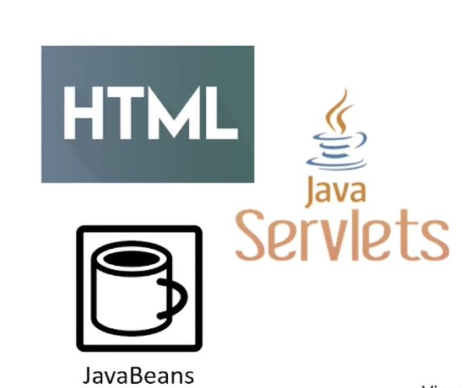
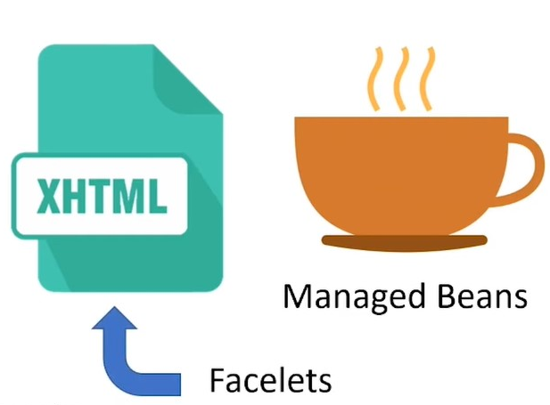
Benefits of JSF
Before JSF
After JSF

Slide 67
JSF Architecture
JSF application is similar to any other Java technology-based web application; it runs in a Java servlet container, and contains:
JavaBeans components as models containing application-specific functionality an data.
A custom tag library representing event handlers and validators.
A custom tag library for rendering UI components
UI components represented as stateful objects on the server
Server-side helper classes
Validators, event handlers, and navigation handlers
Application configuration resource file for configuring application resources
There are controllers which can be used to perform user actions. UI can be created by web page authors and the business logic can be utilized by managed beans.

Slide 68
Components of a JSF Application
A set of web pages to layout UI components
A set of managed beans
A web deployment descriptor (web.xml)
Optionally
Application configuration files (faces-config.xml)
Custom objects, components, custom tags and validators

Slide 69
jSF resources
The Official web site for JSF is http://goo.gl/ktMFjL
Contains tutorials, documentation and articles

Slide 70
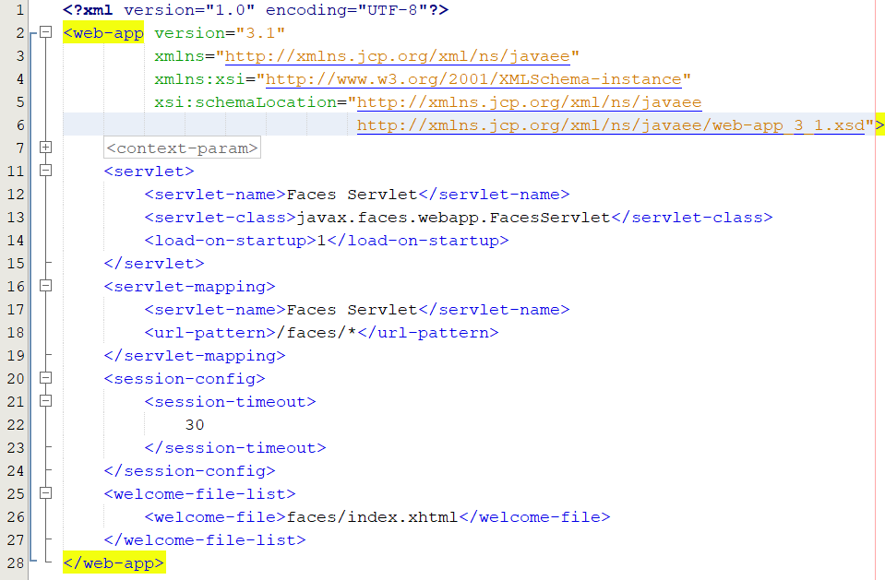
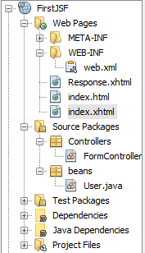
The First JSF example: (web.xml)
Welcome Page

Slide 71
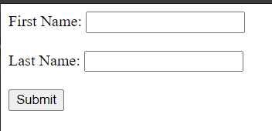


The First JSF example: (index.xhtml)

Slide 72


The First JSF example: (User.java)
ManagedBean

Slide 73

The First JSF example: (FormController.java)
ManagedBean

Slide 74



The First JSF example: (Response.xhtml)

Slide 75
JSF Page Structure
Most common configuration is to use .xhtml file extension.
HTML page with special JSF tags
<html>
… regular html …
… JSF tags …
… more html …
</html>

Slide 76
What are all these JSF HTML tags?
When you build JSF Pages most of the HTML tags have been replaced with an equivalent JSF tag.
The JSF tags are generally pretty similar to their equivalent HTML tag but add support for data binding, AJAX, etc.
Remember JSF DOES NOT have to render HTML so these tags are "wrapper" classes over what they ultimately render.
One of the better resources to learn Enterprise Java is from the Oracle Tutorials.
For Java EE 7 go to: https://docs.oracle.com/javaee/7/tutorial/index.html
For Java EE 8 go to: https://javaee.github.io/tutorial/toc.html

Slide 77
Managed beans
What are Managed Beans?
A managed bean is a regular Java bean class.
Commonly used to hold form data
Can also contain business logic
Created and managed by JSF.

Slide 78
the significance of managed beans
Managed Beans are Java beans that comprise getter and setter methods
And have business logic designed in it.
They may optionally have a backing bean.
They act as a Model for UI components in the MVC framework.

Slide 79
Requirements for Managed beans
Must follow these rules:
Public no-arg constructor
Expose properties via public getter/setter methods
JSF 2 added support for annotation @ManagedBean
Need import javax.faces.bean.ManagedBean library.

Slide 80
JSF Expression Language
When form is submitted,
JSF will call:
user.setFirstName(…)
The JSF expression languages is used to
Access properties of a managed bean
Other logic functions are available too
Basic syntax
#{ <beanName>.<property> }
#{ user.firstName }
To access a bean property from a JSF form:
< h:inputText value="#{user.firstName}" / >
To get a bean property from a JSF page:
User's name is: #{ user.firstName }
When form is processed,
JSF will call:
user.getFirstName(…)

Slide 81
JSF managed bean scope

Slide 82
JSF managed bean scope
The @RequestScoped annotation is used to provide scope for Managed Bean. You can use annotations to define the scope in which the bean will be stored.
The scope of the bean decides whether a new instance of the bean will be created each time or not. You can use following scopes for a bean class:
Application (@ApplicationScoped)
Session (@SessionScoped)
View (@ViewScoped)
Request (@RequestScoped)
None (@NoneScoped)
Custom (@CustomScoped)

Slide 83
JSF managed bean scope
Application scope persists across all users? interactions with a web application.
Session scope persists across multiple HTTP requests in a web application.
View scope persists during a user's interaction with a single page (view) of a web application.
Request scope persists during a single HTTP request in a web application.
Indicates a scope is not defined for the application.
A user-defined, nonstandard scope. Its value must be configured as a java.util.Map. Custom scopes are used infrequently.

Slide 84


Scope Example: (web.xml)

Slide 85



Scope Example: (index.html)

Slide 86

Scope Example: (clickFormscope.xhtml)
Application Scope
clickFormApplicationScoped.xhtml
Session Scope
clickFormSessionScoped.xhtml
Request Scope
clickFormRequestScoped.xhtml

Slide 87



Scope Example: (clickFormscope.xhtml)

Slide 88



Scope Example: Managed Beans

Slide 89
Enterprise Java Bean (EJB)
Introduction to EJB

Slide 90
Introduction
Enterprise Java Beans (EJB) is
Enterprise JavaBeans are server-side components that encapsulate the business logic of an application. The business logic is the code that fulfills the purpose of the application. It DOES NOT perform display of business data (presentation) or perform operations directly the database (persistence).
Enterprise JavaBeans (EJB) simplify application development by automatically taking care of transaction management and security.
There are two types of Enterprise JavaBean:
session beans, which perform business logic,
and message-driven beans, which act as a message listener.

Slide 91
What is business logic?
Prescribes how business objects interact with one another.
Business logic is the portion of an enterprise system which determines how data is transformed or calculate, and how it is routed to people or software (workflow)
For example: Tracking the package:
Order workflow:
Customer creates and order
Warehouse prepares order
Shipping puts the order on a truck
Confirm delivery at your door.
Notes:
Business logic is a thinking parts of you program.
Tracking the package : workflow behind the package

Slide 92

What is business logic?
For example for an eCommerce site: Allow visitors to add items to a shopping cart, specify a shipping address, and supply payment information.

Slide 93

What is business logic?
The business logic of the website might include workflow such as: The sequence of events that happens during the checkout
First asks for the shipping address
Then Billing address
Next page will contain the payment method
And last page will show congratulations
Think workflow, what tasks, and what order.

Slide 94

Business Logic – Decisions to be made

Slide 95
What is a business rule?
A business rule that defines or constrains some aspect of business and always resolves to either true or false
Business rules describe the operations, definitions and constraints that apply to an organization.
Business rules can apply to people, processes, corporate behavior and computing systems in an organization, and are put in place to help the organization achieve its goals.
For example:
No credit check is to be performed on return customers.
Cannot withdraw more money from your account then your balance.
Cannot buy items with a credit card if the card authorization fails.

Slide 96

Example Business Logic for a shopping cart

Slide 97
EJB container
An EJB container manages the enterprise beans contained within it.
For each enterprise bean, the container is responsible for
registering the object,
providing a remote interface for the object,
creating and destroying object instances,
checking security for the object,
managing the active state for the object,
and coordinating distributed transactions.

Slide 98

EJB Container
Java EE Server

Slide 99
Stateless and Stateful
What are the differences?
Stateless objects for all users (application level).
Stateful objects for individual user (session level).
Stateless objects can be a service for all users
They created when a method/application is called/started.
They are the same objects visible to all users but don’t hold state for each user.
Stateful objects are not shared among users
They hold state for individual user.
They will die when client sessions are ended or timeout.

Slide 100


Example of Stateless and Stateful
Stateless
unique
Application level
counters, switches, etc.
Every user will retrieve the same object
Stateful
multiple
Session level
shopping carts, etc.
Every user has its own object to hold different value

Slide 101
What is inversion of control?
Inversion of control (IoC) is a programming technique.
IoC is expressed in terms of object-oriented programming in which object coupoing is bound at run time by an dependent object that is typically not known at compile time using static analysis.
Use Cases:
Services such as Logging, Business services, Data Access services.
Mock implementation for Test Driven Development or Unit Test

Slide 102
What is Contexts And dependency Injection (CDI)?
Primarily is used to support Inversion of Control (IoC).
Any Java Class or EJB can be injected if it meets the following:
It is not a non static inner class.
It is a concrete class or is annotated @Decorator
It is not annotated with an EJB component-defining annotation or declared as an EJB bean class in ejb-jar.xml
It has an appropriate constructor. That is , one of the following is the case:
The class has a constructor with no parameters.
The class declares a constructor annotated @Inject.
Notes:
不是靜態內部類
Not abstract class

Slide 103
Types of EJB
EJB is primarily divided into three categories;
Session Bean: Session bean stores data of a particular user for a single session. It can be stateful or stateless. It is less resource intensive as compared to entity bean. Session bean gets destroyed as soon as user session terminates.
Entity Bean: Entity beans represent persistent data storage. User data can be saved to database via entity beans and later on can be retrieved from the database in the entity bean.
Message Driven Bean: Message driven beans are used in context of JMS (Java Messaging Service). Message Driven Beans can consumes JMS messages from external entities and act accordingly.

Slide 104
Benefits
Following are the important benefits of EJB
Simplified development of large-scale enterprise level application.
Application Server/EJB container provides most of the system level services like transaction handling, logging, load balancing, persistence mechanism, exception handling, and so on. Developer has to focus only on business logic of the application.
EJB container manages life cycle of EJB instances, thus developer needs not to worry about when to create/delete EJB objects.

Slide 105
EJB Example
Stateless Bean

Slide 106
Stateless Bean
A stateless session bean is a type of enterprise bean, which is normally used to perform independent operations.
A stateless session bean as per its name does not have any associated client state, but it may preserve its instance state.
EJB Container normally creates a pool of few stateless bean's objects and use these objects to process client's request.
Because of pool, instance variable values are not guaranteed to be same across lookups/method calls.

Slide 107
Steps to Create a Stateless EJB
Following are the steps required to create a stateless EJB
Create a remote/local interface exposing the business methods. This interface will be used by the EJB client application.
Use @Local annotation, if EJB client is in same environment where EJB session bean is to be deployed.
Use @Remote annotation, if EJB client is in different environment where EJB session bean is to be deployed.
Create a stateless session bean, implementing the above interface.
Use @Stateless annotation to signify it a stateless bean. EJB Container automatically creates the relevant configurations or interfaces required by reading this annotation during deployment.

Slide 108



EJB Example
The Project Structure:
Layouts (Page templates, Facelets)
JSF Pages
Beans (Data Objects)
Business (EJB)
Controllers(Managed Bean)

Slide 109



commonHeader.xhtml
commonFooter.xhtml
commonContent.xhtml

Slide 110

commonLayout.xhtml
Header Template
Content Template
Footer Template

Slide 111

Login-form.xhtml

Slide 112

Order.java (constructors)

Slide 113


Order.java (getters and setters)

Slide 114


User.java
getters and setters
Constructor

Slide 115

OrderBusinessInterface.java
Local Annotation

Slide 116

OrderBusinessService.java
@Stateless
@Local
@Alternative
Constructor
Creates order List

Slide 117

OrderBusinessService.java (Cont.)

Slide 118

AnotherOrderBusinessService.java
@Stateless
@Local
@Alternative
Constructor
Creates another order List

Slide 119

AnotherOrderBusinessService.java (Cont.)

Slide 120

FormController.java
Two methods
onSubmit()
getService()
Inject Annotation

Slide 121

FormController.java
(onSubmit, getService)

Slide 122

Response.xhtml

Slide 123

Response.xhtml (Cont.)

Slide 124


beans.xml
OrderBusinessService
AnotherOrderBusinessService

Slide 125





Slide 126
Service Oriented Architecture
Microservices

Slide 127
Introduction to Services
Service-oriented architecture (SOA) is a style of software design where services are provided to the other components by application components, through a communication protocol over a network.
A service is a discrete unit of functionality that can be accessed remotely.
Server-to-server, Server-to-PC, Server-to-mobile, etc.
Services are designed as stateless for server components and devices to share enterprise resources.

Slide 128

Typical system architecture of an enterprise
An enterprise Food to Go (FTGO) has a conventional system architecture.
The business logics are located in the middle surrounded by various adapters for external systems and client devices to communicate.
Software modules are tightly connected (depended on each other).

Slide 129
The Monolithic style
FTGO is a logically modular architecture, and it is packaged into a single WAR file.
It is a tightly coupled software architecture.
It is a widely used monolithic style of software architecture in modern applications.
Simple to develop;
Easy to make radical changes to the application;
Straightforward to test;
Straightforward to deploy;
Easy to scale.

Slide 130

Issues of Monolithic Style
As FTGO grows, the application becomes very complicated.
It’s too large for any developer to fully understand.
The whole deployment process is long and arduous.

Slide 131
Introduction to Microservices
We can use the microservice architecture to simplify building a large, complex enterprise level applications.
Applications must be decomposed into software modules (decentralization).
The microservice architecture uses services as the unit of modularity.
A service has an API to do small task independently.
Those services can be deploy and scale separately over time.

Slide 132

Microservice architecture
Adopt the
microservice
architecture
for FTGO.

Slide 133

Tight and loose coupling
Microservice is a loosely coupled service. Software modules are suggested to be connected loosely.

Slide 134
Tight and loose coupling (cont.)
Content coupling occurs when one module uses the code of other module, for instance a branch.
Common coupling occurs when several modules have access to the same global data
Control coupling is one module controlling the flow of another, by passing it information on what to do.
Stamp coupling occurs when modules share a composite data structure and use only parts of it, possibly different parts.
Data coupling occurs when modules share data through parameters.

Slide 135
Benefits and Drawbacks
The benefits of using microservice architecture:
It enables the continuous delivery and deployment of large, complex applications.
Services are small and easily maintained.
Services are independently deployable and scalable.
Each service can be deployed on hardware that’s best suited to its resource requirements (CPU, memory, etc.).
The microservice architecture enables teams to be autonomous.
It allows easy experimenting and adoption of new technologies.

Slide 136
Benefits and Drawbacks (cont.)
The drawbacks of using microservice architecture:
Finding the right set of services is challenging.
Distributed systems are complex, which makes development, testing, and deployment difficult.
Deploying features that span multiple services requires careful coordination.
Deciding when to adopt the microservice architecture is difficult.
Duplicated data may appear.

Slide 137
Web Service Implementation
RESTful Web Service

Slide 138

Web service
The term Web Service is a server running on a computer device, listening for request at a particular port over a network, serving web documents (HTML, JSON, XML, images …).
In practice, a web service commonly provides an object-oriented Web-based interface to a database server, utilized for example by another Web server, or by a mobile app, that provides a user interface to the end-user.

Slide 139
Web Service API?
If you are software developer and you want to use a web service, you need to know the application programming interface or API for that service.
Application Programming Interface (API)
Defines everything you need to communicate with a web service.

Slide 140
Elements of a Web Service API
Message format
SOAP, XML, JSON, other?
Request syntax
Named methods
Uniform Resource Identifier (URI)
Parameter names and data types
Requesting an action
Named methods
HTTP verbs (POST, GET, PUT, PATCH, DELETE)
Receiving the data
Formats: SOAP, XML, JSON
Metadata: describes data structure, including field/property names and data types.

Slide 141
What is REST?
REST is an architectural style which is based on web-standards and the HTTP protocol. This style was initially described by Roy Fielding in 2000.
In a REST based architecture everything is a resource. A resource is accessed via a common interface based on the HTTP standard methods.
In a REST based architecture you have a REST server which provides access to the resources. A REST client can access and modify the REST resources.
A RESTFul web services are based on HTTP methods and the concept of REST.

Slide 142
Introduction to Restful web service
In the web services terms, Representational State Transfer (REST) is a stateless client-server architecture.
It's an architecture for well behaved Web services that can function at Internet scale.
It is a member of SOA
It uses simple HTTP Protocol for data communication (CRUD operations).
It supports various formats for data communication:
JSON, XML, Plain text (string), etc.
Enterprise components use XML to transfer structural data in the past but using JSON format is more popular now.
Famous web service development standards in enterprise systems.
Heavyweight: SOAP (Simple Object Access Protocol) uses WSDL for development and XML for message format.
Lightweight: RESTful uses HTTP protocol for data communication.

Slide 143
RESTful Architecture
In RESTful architecture, a RESTful server simply provides access to its resources by URIs / Global IDs.
Using the standard HTTP methods for action call:
PUT− Used to create a new resource;
GET− Provides a read only access to a resource;
POST− Used to update or create a resource;
DELETE− Used to delete a resource;
OPTIONS− Used to get the supported operations on a resource.
Match the DML (Data Manipulation Language) and CRUD transactions with the HTTP protocols.
INSERT, SELECT, UPDATE, DELETE

Slide 144


REST API
Request Example
https://api.flickr.com/services/rest/?method=flickr.photos.getinfo&photo_id=2079357948
REST API ENDPOINT URL METHOD PARAMETERS
REQUEST
REST API: endpoint URL + API method + parameters
RESPONSE
Representation of resource
REST XML-PRC SOAP JSON Serialized PHP

Slide 145
RESTful Design Principles
For client devices (mobile, notebook, PC, IPTV, etc.) to get enterprise resources ( production, property, service information, etc. ).
Define resources for online manipulation:
Use URI to represent resources
Design the path with noun but not verb or action
http://servername/product/123
(use GET protocol to retrieve product information with product ID 123)
Use HTTP protocols for action call
http://servername/UpdateProduct/123/xxx/yyy (bad design)
http://servername/product/{ID}
(use POST protocol with JSON for update product information)

Slide 146
RESTful design principles (cont. )
All resources should be defined as stateless
Server should never keep client state (session)
Advantages of Statelessness
Web services can treat each method request independently
Web services need not maintain the client's previous interactions. It simplifies the application design.
As HTTP is itself a statelessness protocol, RESTful Web Services work seamlessly with the HTTP protocols.
Disadvantages of Statelessness
Web services need to get extra information in each request if the applications require to interact with clients.

Slide 147
Java API for RESTful Web Services
The standard is specified in JSR 370 (JAX-RS)
Jersey adopts the standard for java developers
Use POJO (Plain Old Java Object) for development
Annotation driven (@...)
Apache Tomcat server
RESTful
Web Services
Clients
RESTful
Web services
Create
Retrieve
Update
Delete
HTTP POST
HTTP GET
HTTP PUT
HTTP DELETE
Jersey Servlet Container
Java Web App

Slide 148
RESTful in Practice
RESTful Product example

Slide 149
RESTful in Practice
Create a Dynamic Web Project in IDE
Adopt the Jersey library files
https://jersey.github.io
Change the web.xml file
Create JavaBeans for generating the outputting data in JSON and/or XML formats
Create a service for the server resources
Use Postman or Insomnia tools for testing
Read http://www.tutorialspoint.com/restful/ for more information

Slide 150

Create a Dynamic Web Project in IDE (NetBeans)
Change the web.xml file
Create jersey servlet mapping
Create a service API for the server resources
Create JavaBeans for generating the outputting data
Adopt the Jersey library files

Slide 151


Adopt the Jersey library files (Using maven)

Slide 152


Change the web.xml file
Create jersey servlet mapping

Slide 153


Create JavaBeans for generating the outputting data
Product bean
Constructors

Slide 154

Create JavaBeans for generating the outputting data
Product bean
Getters and Setters

Slide 155

Create JavaBeans for generating the outputting data
Product bean
Useful functions
for serializable objects

Slide 156


Create JavaBeans for generating the outputting data
Product DAO
data access object (DAO) is a pattern that provides an abstract interface to some type of database or other persistence mechanism.

Slide 157

Create JavaBeans for generating the outputting data
Product DAO
Methods for managing Data

Slide 158



Create a RESTful service API for the server resources
Jersey Annotation @Path
Defines the URI for the product resource
Jersey Annotation @GET
Defines the GET protocol for client to access

Slide 159
Create a RESTful service API for the server resources
Jersey Annotation @Path
Defines the URI for the product resource
Jersey Annotation @Produces
Defines the output format as JSON

Slide 160

Create a RESTful service API for the server resources
Jersey Annotation @Produces
Defines the output format as XML
Jersey Annotation @PathParam
Retrieves the input parameter form URI and assigns the value to the int id.

Slide 161

Create a RESTful service API for the server resources
Jersey Annotation @Consumes annotation is used to specify which MIME media types of representations a resource can accept
Jersey Annotation @FormParam
Retrieves the input parameter form a form and assigns the value to the int quantity and float price.

Slide 162

Create a RESTful service API for the server resources

Slide 163
RESTful JAX-RS Annotations
Annotation | Description
@Path | It identifies the URI path. It can be specified on class or method.
@PathParam | represents the parameter of the URI path.
@GET | specifies method responds to GET request.
@POST | specifies method responds to POST request.
@PUT | specifies method responds to PUT request.
@DELETE | specifies method responds to DELETE request.
@Produces | defines media type for the response such as XML, PLAIN, JSON etc. It defines the media type that the methods of a resource class or MessageBodyWriter can produce.

Slide 164

Index.html

Slide 165

RESTful Client Tools
Postman, Insomnia to submit HTTP (POST, GET, etc.)
https://web.postman.com

